Slide 1
Zomato Analytics
Cheetiralla Veera Bharath

Slide 2
Tools Used
Microsoft Excel
Tableau
Microsoft Power Bi
MYSQL

Slide 3
Overview
The Zomato Analytics project involves analyzing customer behavior, restaurant trends, and business metrics using a dataset from Zomato. The goal is to uncover actionable insights, such as popular cuisines, top-performing restaurants, pricing patterns, and customer ratings. The analysis is performed using tools like Python, SQL, and visualization platforms (Power BI/Tableau), enabling data-driven decision-making for stakeholders in the food delivery industry.

Slide 4
Extract Data/Import Files
Transform Data (remove blank and duplicates)
. Manage Relationships
KPI and Visualization
Dashboard
PROJECT WORKFLOW

Slide 5
Main KPI’S
Find the Numbers of Restaurants based on City and Country.
Numbers of Restaurants opening based on Year , Quarter , Month
Count of Restaurants based on Average Ratings
Create buckets based on Average Price of reasonable size and find out how many restaurants falls in each buckets
Percentage of Restaurants based on "Has_Table_booking"
Percentage of Restaurants based on "Has_Online_delivery"
Develop Charts based on Cuisines, City, Ratings

Slide 6
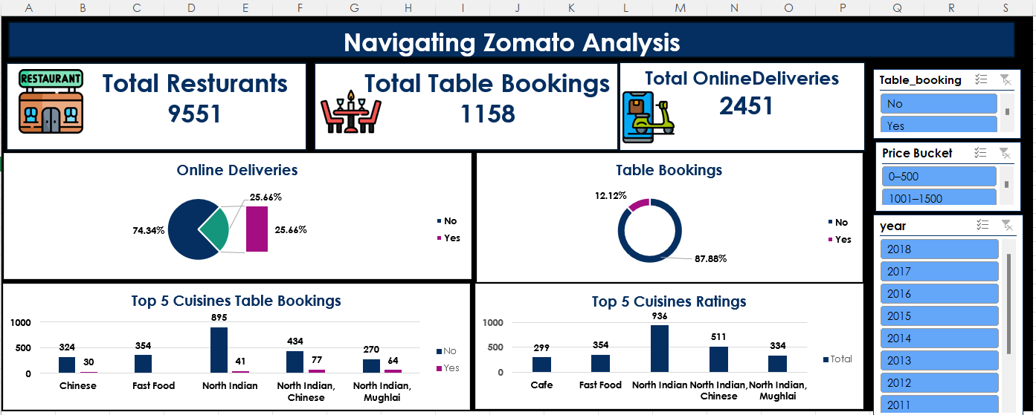
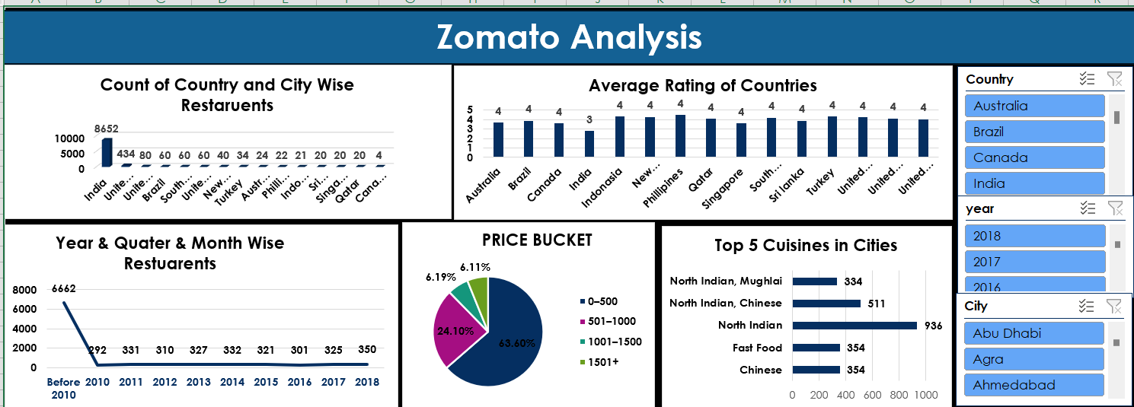
Excel Dashboards

Slide 7
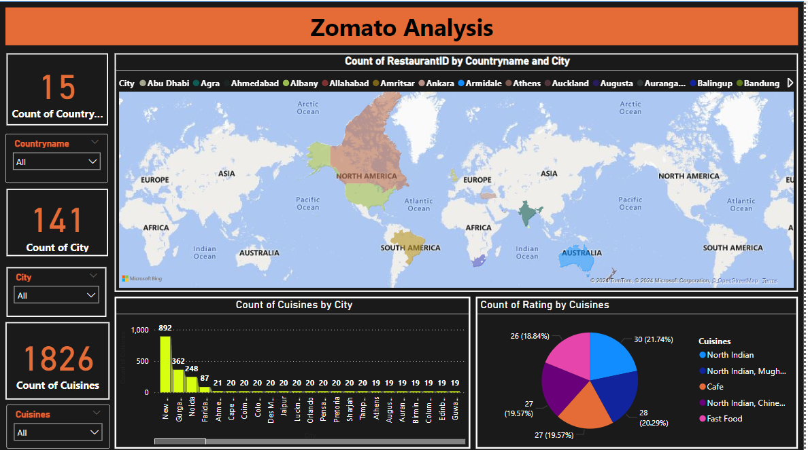
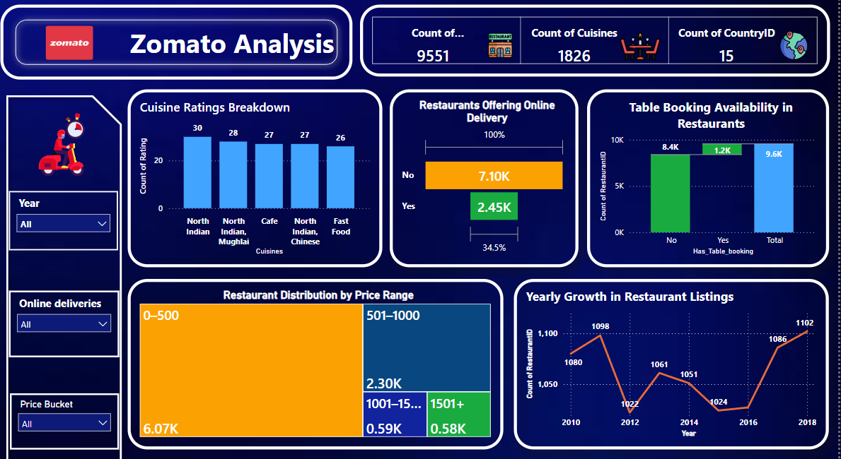
Power Bi Dashboards

Slide 8
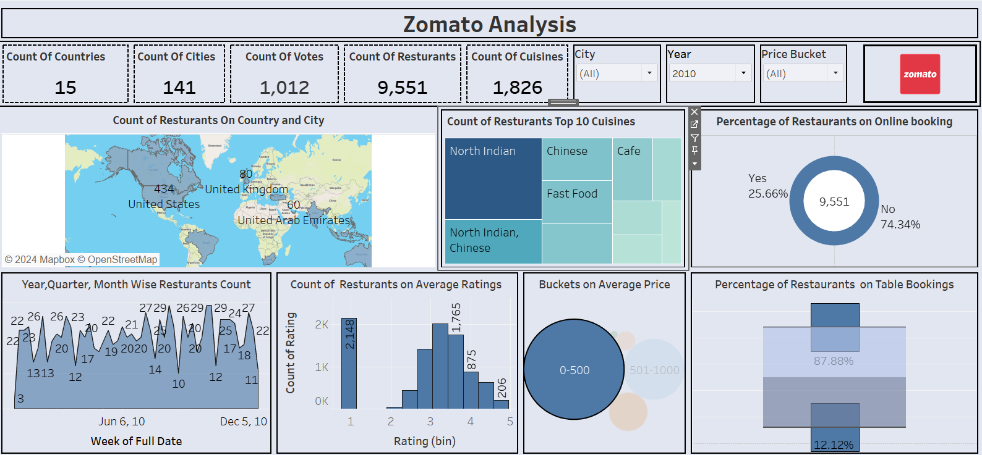
Tableau Dashboard

Slide 9
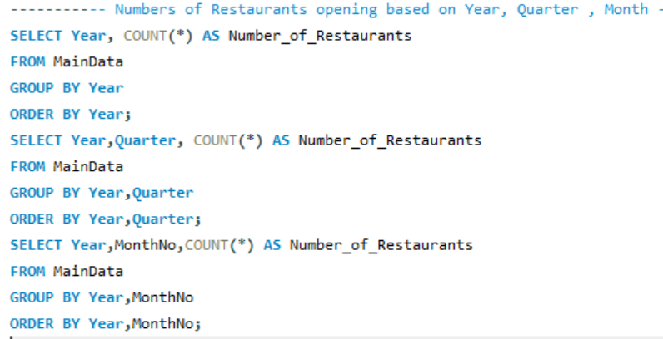
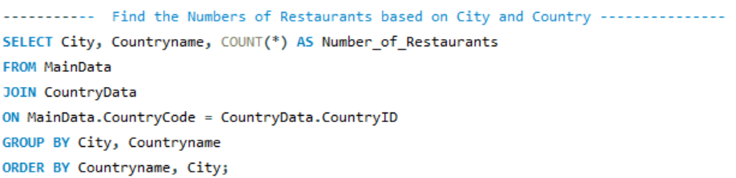
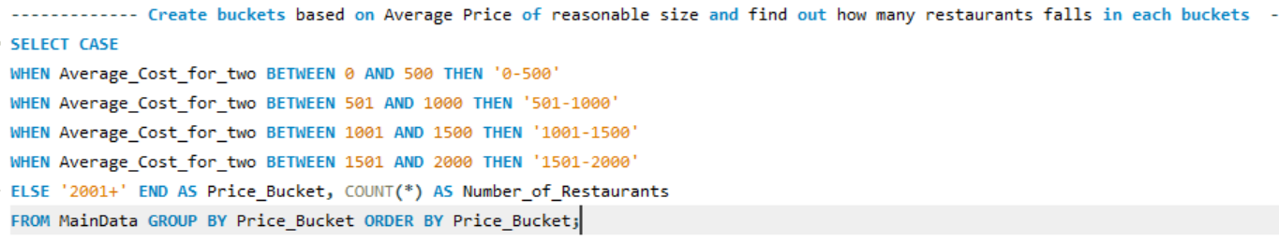
MYSQL Queries

Slide 10
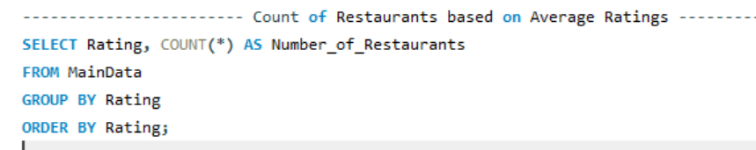
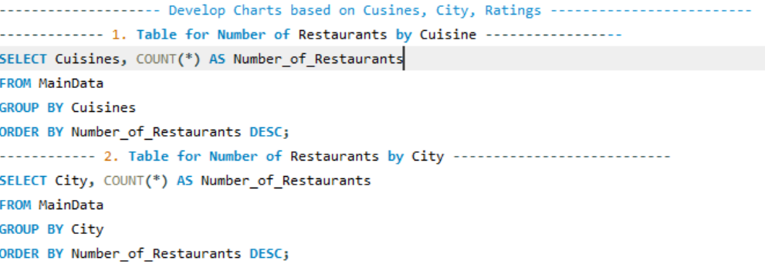
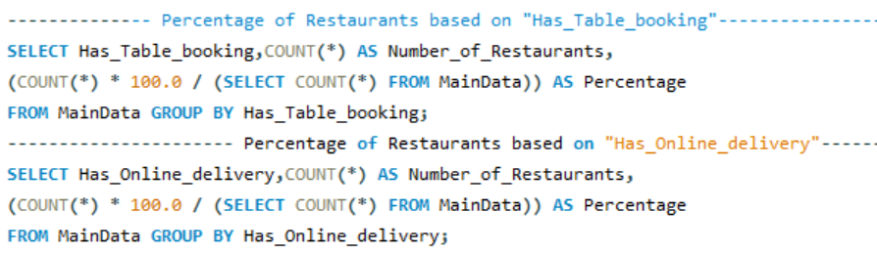

Slide 11
Key Insights from Zomato Analytics
Customer Preferences:
Indian and Chinese cuisines are the most popular among customers.
Higher ratings correlate with restaurants offering diverse menu options.
Pricing Patterns:
Restaurants with moderate pricing (₹300-₹500 per meal) attract the most customers.
Discounts and offers significantly boost order volume.
Location Trends:
Urban areas have a higher density of top-rated restaurants.
Specific areas show a demand-supply gap in certain cuisines.
Operational Metrics:
Delivery time impacts customer satisfaction scores.
Weekend orders show a 30% spike compared to weekdays.

Slide 12
Strategic Recommendations Based on Analytics
Menu Optimization: Expand Indian and Chinese cuisine options to meet customer demand.
Pricing Strategy: Focus on mid-range pricing with periodic promotional offers to attract budget-conscious customers.
Location Expansion : Target under-served areas with high demand for specific cuisines.
Operational Improvements: Reduce delivery times by optimizing logistics and increasing delivery fleet size.
Customer Engagement: Introduce loyalty programs and personalized discounts for repeat customers.
Weekend Focus: Increase workforce and offer exclusive deals during weekends to capitalize on high demand.

Slide 13
Thank You !

